Slide 1
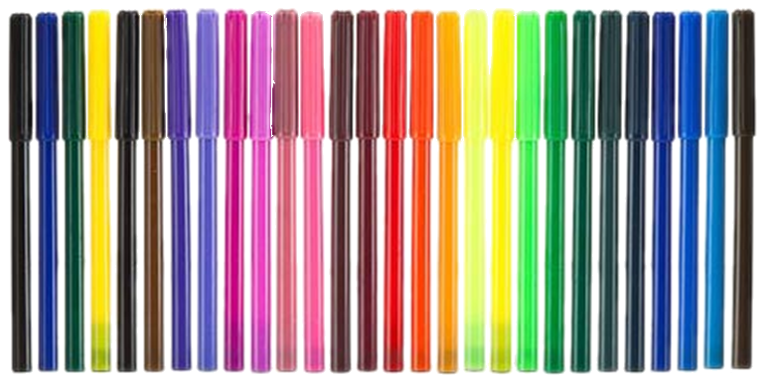
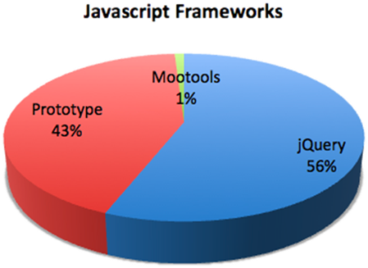


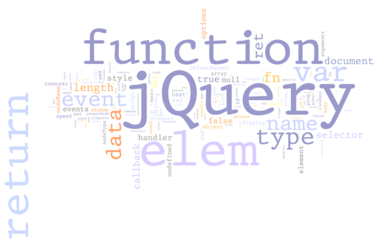

jQuery Overview
Unleash the Power of jQuery
HTML, CSS and JavaScript
Telerik School Academy
http://academy.telerik.com

Slide 2

Table of Contents
What is jQuery?
jQuery Fundamentals
Selectors
DOM Manipulation
DOM Altering
jQuery DOM elements
AJAX
jQuery AJAX Methods
Executing AJAX Requests

Slide 3
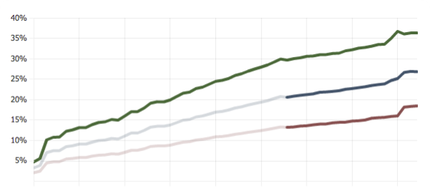
What is jQuery?
The world’s most popular JavaScript library

Slide 4
What is jQuery?
jQuery is a cross-browser JavaScript library
Designed to simplify the client-side scripting of HTML
The most popular JavaScript library in use today
Free, open source software
jQuery's syntax is designed to make it easier to
Navigate a document and select DOM elements
Create animations
Handle events

Slide 5
What is jQuery? (2)
jQuery also provides capabilities for developers to create plugins for
Low-level interaction and animation
Advanced effects and high-level, theme-able widgets
Creation of powerful and dynamic web pages
Microsoft adopted jQuery within Visual Studio
Uses in Microsoft's ASP.NET AJAX Framework and ASP.NET MVC Framework

Slide 6
Why jQuery is So Popular?
Easy to learn
Fluent programming style
Easy to extend
You create new jQuery plugins by creating new JavaScript functions
Powerful DOM Selection
Powered by CSS 3.0
Lightweight
Community Support
Large community of developers and geeks

Slide 7
How to Add jQuery to a Web Site?
Download jQuery files from
http://www.jquery.com
Self hosted
You can choose to self host the .js file
E.g. jquery-2.1.1.js or .min.js file
Use it from CDN (content delivery network)
Microsoft, jQuery, Google CDNs
e.g. http://code.jquery.com/jquery-2.1.1.min.js,
http://ajax.microsoft.com/ajax/jquery/jquery-2.1.1.min.js
Notes:
Talking Points:
You can choose to self host files - this is including jQuery in the scripts folder in Visual Studio.
Can also just include jQuery from a CDN - simply change the script reference to point to jQuery on the CDN
Can be faster loading and client browser may already have jQuery file cached
Be careful! If the CDN goes down your site may also go down.
Source version is human readable.
Always include the minified version for your production code.

Slide 8




Selectors and DOM Manipulation

Slide 9
Selectors
Selection of DOM elements in jQuery is much like as in pure JavaScript
Selection of elements using CSS selectors
Like querySelectorAll
$(selector)
//by tag
$("div") //document.querySelectorAll("div");
//by class
$(".menu-item")
//document.querySelectorAll(".menu-item");
//by id
$("#navigation")
//by combination of selectors
$("ul.menu li")

Slide 10
Selection with jQuery
Selecting items with jQuery
Almost always returns a collection of the items
Even if there is only one item
Can be stored in a variable or used right away
The usage of the elements is always the same, no matter whether a single or many elements
More at: http://learn.jquery.com/using-jquery-core/selecting-elements/
// select the item
$("#something").hide();
$(".widgets").fade(1);

Slide 11
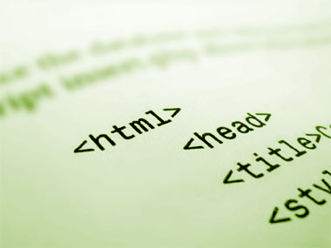
Selection with jQuery
Live Demo

Slide 12
DOM Traversal
Traversing the nodes of the DOM

Slide 13
DOM Traversal
As with plain JavaScript, the DOM can be traversed with jQuery
Properties for:
Next and previous siblings
Parents and children

Slide 14
DOM Traversal: Next and Previous
jQuery.next(), jQuery.prev()
Returns the next/prev sibling
Returns an HTML element
Not a [text] node
<ul>
<li>Item 1</li>
<li>Item 2</li>
<li>Item 3</li>
</ul>
var $first = $("li").first();
log($first);
//logs "Item 1"
log($first.next());
//logs "Item 2"

Slide 15
Next/Prev Siblings
Live Demo

Slide 16
DOM Traversal: Parent
jQuery.parent()
Returns the parent of the element
jQuery.parents(selector)
Returns the first parent that matches the selector
<div id="wrapper">
<ul id="items-list">
<li>Item 1</li>
<li>Item 2</li>
<li class="special">Item 3</li>
<li>Item 4</li>
</ul>
</div>
var $node = $(".special");
$node.parent().attr("id"); //logs "items-list"
$node.parents("div").attr("id");
//logs "wrapper"
$node.parents("#wrapper") .attr("id");
/logs "wrapper"

Slide 17
Parent Element
Live Demo

Slide 18
Altering the DOM
Adding and removing DOM elements

Slide 19

Adding Elements
Adding elements can
be done on the fly
jQuery.appendTo()/prependTo()
jQuery.append()/prepend()
$('<ul><li>Hello</li></ul>').appendTo('body');
$("body").prepend("<h1>header</h1>");

Slide 20
Creating elements
Creating new elements is also easy
var $divElement = $('<div>');
var $anotherDivElement = $('<div />');

Slide 21
Adding Elements to the DOM
Live Demo

Slide 22
Removing Elements
You can also remove elements from the DOM
Just as easy
// Before
<div>
<p>Red</p>
<p>Green</p>
</div>
// Removing elements
$('p').remove();
// After
<div>
</div>

Slide 23

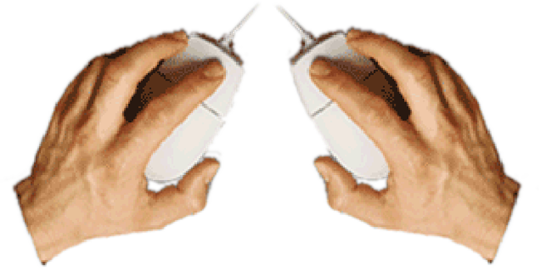

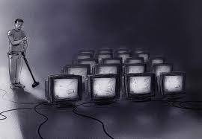
Removing Elements
Live Demo

Slide 24
jQuery Extended DOM Elements

Slide 25
jQuery Objects
Selected with jQuery DOM elements are NOT pure DOM elements
They are extended
Have additional properties and methods
addClass(), removeClass(), toogleClass()
on(event, callback) for attaching events
animate(), fade(), etc…
//Parsing a regular DOM element to jQuery Element
var content = document.createElement("div");
var $content = $(content);

Slide 26
Properties of jQuery Elements
jQuery elements extend regular DOM elements
Methods for altering the elements
jQuery.css("color", "#f3f")
jQuery.html() returns the innerHTML
jQuery.html(content) sets the innerHTML
jQuery.text(content) sets the innerHTML, by escaping the content

Slide 27
Properties of jQuery Elements
Live Demo

Slide 28
jQuery Events
Cross-browser events

Slide 29
jQuery Events
jQuery has a convenient way for attaching and detaching events
Works cross-browser
Using methods on() and off()
function onButtonClick(){
$(".selected").removeClass("selected");
$(this).addClass("selected");
}
$("a.button").on("click", onButtonClick);

Slide 30
jQuery Events
Optimize the event
Add it on the parent element
A bit different syntax
function onListItemClick(){
$(".selected").removeClass("selected");
$(this).addClass("selected");
}
$("ul").on("click", "li", onListItemClick);

Slide 31

jQuery Event Handlers
Live Demo

Slide 32
jQuery Chaining
Call after call, after call… Like an angry girlfriend

Slide 33
jQuery Chaining
The chaining paradigm is as follows:
If a method should return result -> Ok, return it
If a method should NOT return a result -> return this
jQuery implements this paradigm, so methods can be chained to one another:
$('<button />')
.addClass('btn-success')
.html('Click me for success')
.on('click', onSuccessButtonClick)
.appendTo(document.body);

Slide 34
jQuery Chaining
Live Demo

Slide 35
jQuery AJAX
Creating HTTP requests with jQuery

Slide 36
jQuery AJAX
AJAX stands for Asynchronous JavaScript and XML
Meaning asynchronously get data from a remote place and render it dynamically
jQuery provides some methods for AJAX
jQuery.ajax(options) – HTTP request with full control (headers, data, method, etc…)
jQuery.get(url) – HTTP GET request
jQuery.post(url) – HTTP POST request
jQuery(selector).load(url) – loads the contents from the url inside the selected node

Slide 37
jQuery AJAX
Live Demo

Slide 38
jQuery Overview
?
?
?
?
?
Questions?
?
?
?
?
?
?

Slide 39
Homework
Create a slider control using jQuery
The slider can have many slides
Only one slide is visible at a time
Each slide contains HTML code
i.e. it can contain images, forms, divs, headers, links, etc…
Implement functionality for changing the visible slide after 5 seconds
Create buttons for next and previous slide

Slide 40
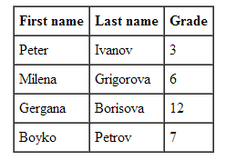
Homework (2)
Using jQuery implement functionality to insert a DOM element before or after another element
By given an array of students, generate a table that represents these students
Each student has first name, last name and grade
Use jQuery
Implement functionality to change the background color of a web page
i.e. select a color from a color picker and set this color as the background color of the page

Slide 41
Homework (3)
*Implement a GridView control
Rows can be added dynamically
A header row can be added dynamically
Each GridView can have at most one header row
Each row can have a nested GridView
Each GridView can have at most one nested GridView

Slide 42
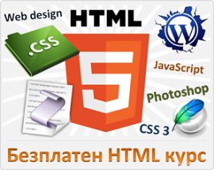


Free Trainings @ Telerik Academy
"Web Design with HTML 5, CSS 3 and JavaScript" course @ Telerik Academy
html5course.telerik.com
Telerik Software Academy
academy.telerik.com
Telerik Academy @ Facebook
facebook.com/TelerikAcademy
Telerik Software Academy Forums
forums.academy.telerik.com

